Slide 1


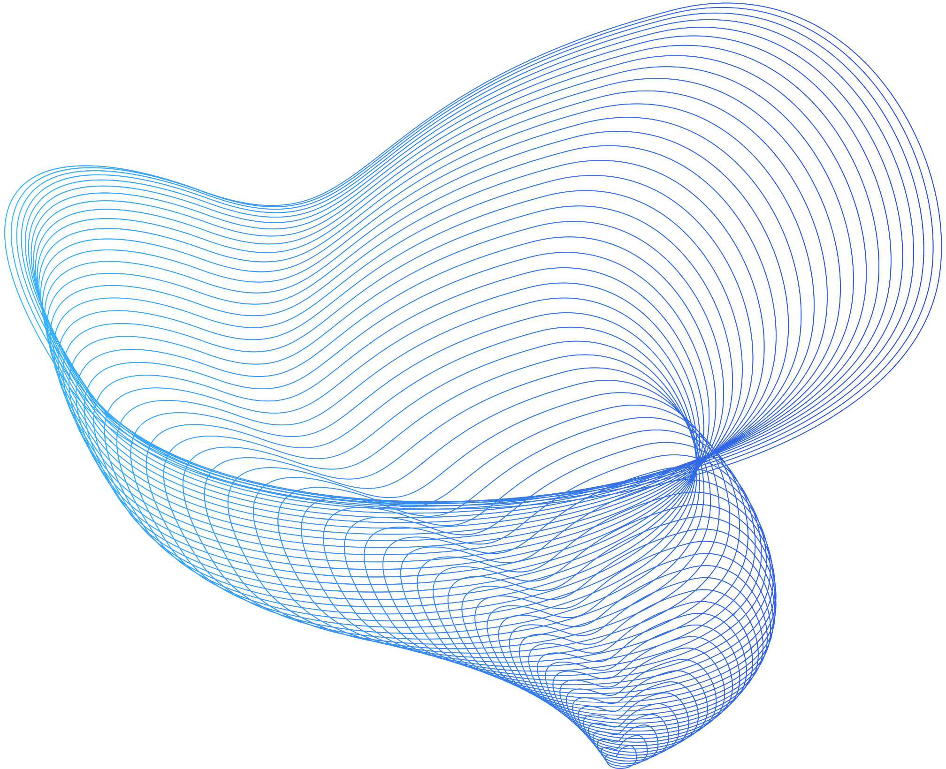


Statistical Inference & Data Mining
iWildCam 2019 Contest
Efi Korenfeld & Saar Ben-Yochana

Slide 2
ROADMAP
1
2
3
4
5
Data Exploration
Image Pre-Processing
Object Detection
Model & Training
Predictions & Results
Analyze the data
Extend missing
Adjust image colors
White-balance
CLAHE
Separate empty and non-empty images
Evaluate the accuracy, confusion-matrix
Pre-Trained model
Transfer Learning
Hyperparameters
Transforms
Apply trained model on the test set
submission results

Slide 3
Count | Label
131,457 | Empty
14,106 | Opossum
8,623 | Raccoon
7,209 | Coyote
6,938 | Rabbit
6,102 | Deer
5,975 | Bobcat
4,759 | Cat
3,398 | Squirrel
3,035 | Dog
2,210 | Rodent
1,361 | Skunk
1,093 | Fox
33 | Mountain Lion
DATA EXPLORATION
Empty
Opossum
Raccoon
Coyote
Rabbit
Deer
Bobcat
Cat
Squirrel
Dog
Rodent
Skunk
Fox
Mountain Lion
150,000
Observations
Many empty images (~60%)
9 classes are missing
Very unbalanced dataset
100,000
50,000
0

Slide 4
Count | Label
131,457 | Empty
14,106 | Opossum
11,199 | Deer
11,163 | Raccon
9,490 | Coyote
8,948 | Rabbit
8,111 | Squirrel
Count | Label
7,213 | Bobcat
4,954 | Cat
3,411 | Small Mammal
3,035 | Dog
2,281 | Fox
2,274 | Rodent
2,077 | Skunk
905 | Black Bear
429 | Antelope
314 | Bison
254 | Sheep
179 | Mountain Lion
144 | Mountain Goat
37 | Wolf
22 | Moose
9 | Elk
EXTEND THE
DATA - I
iNaturalist Idaho Supplemental Training Data (2017-2019)
Dog
1.4%
Skunk
1%
Bobcat
3.3%
Squirrel
3.7%
Rabbit
4.1%
Coyote
4.4%
Raccoon
5.1%
Deer
5.2%
Empty
60.6%
Opossum
6.5%
https://www.kaggle.com/code/rbarman/iwildcam-2019-inat-idaho-resized

Slide 5
EXTEND THE
DATA - II
Empty
Opossum
Deer
Raccoon
Coyote
Rabbit
Squirrel
Bobcat
Cat
Small Mammal
Dog
Fox
Rodent
Skunk
Black Bear
Antelope
Bison
Sheep
Mountain Lion
Mountain Goat
Wolf
Moose
Elk
iNaturalist Idaho Supplemental Training Data (2017-2019)
150,000
100,000
50,000
Note: Still too many empty images
0
https://www.kaggle.com/code/rbarman/iwildcam-2019-inat-idaho-resized

Slide 6

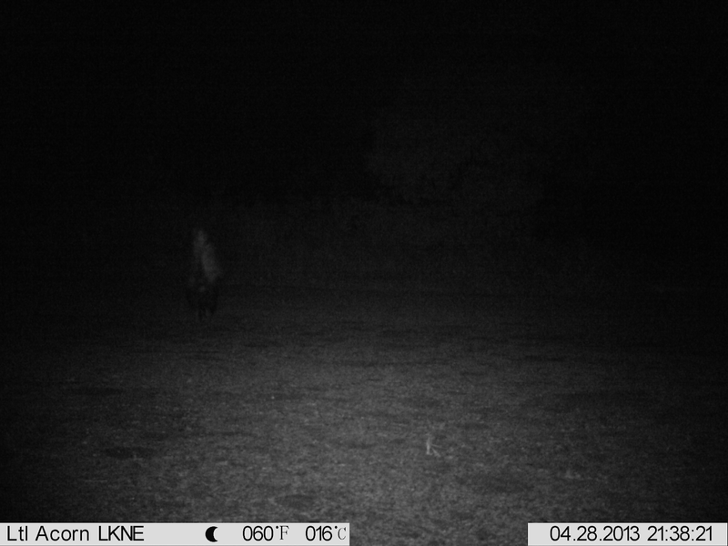
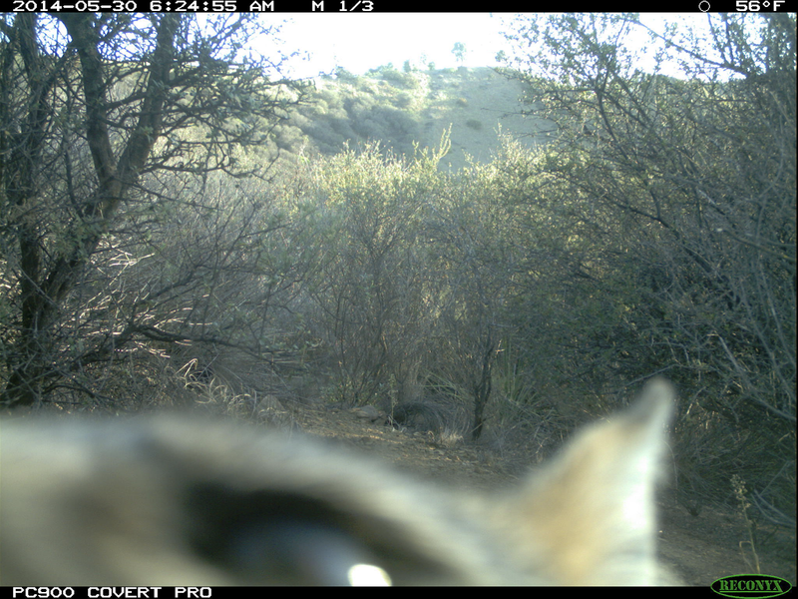

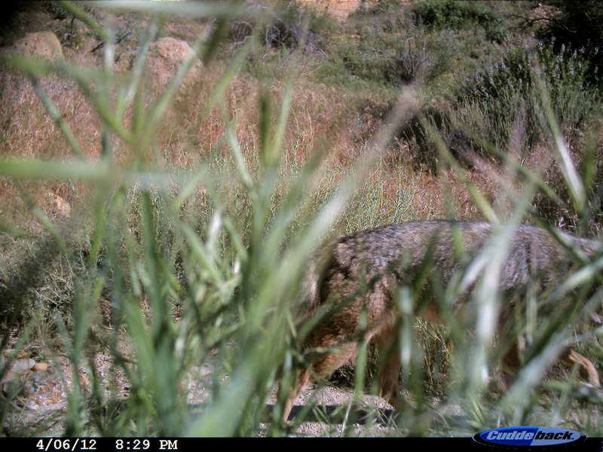
IN-DEPTH ANALYSIS
Data Challenges:
Illumination
Motion Blur
Small Region of Interest
Occlusion
Perspective
Weather Conditions
Camera Malfunctions
Used CLAHE (Contrast Limited Adaptive Histogram Equalization) & SimpleWB (White Balance) methods to improve the ability of object identification.
https://www.kaggle.com/code/seriousran/image-pre-processing-for-wild-images/notebook

Slide 7
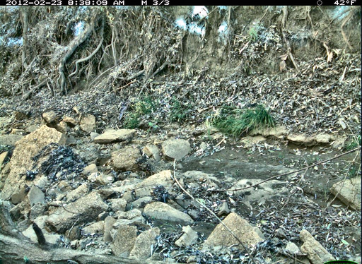
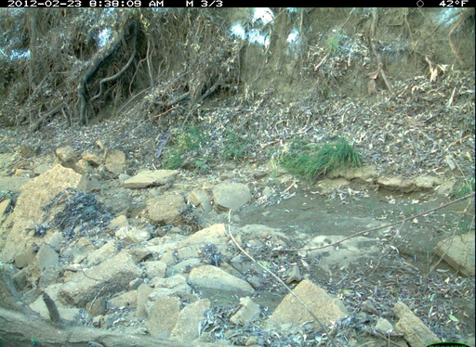
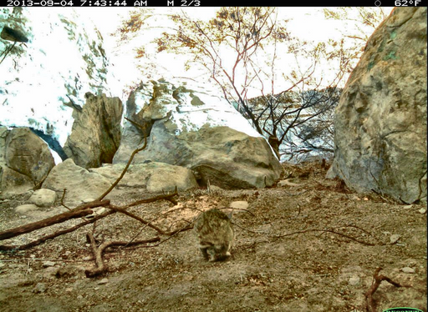
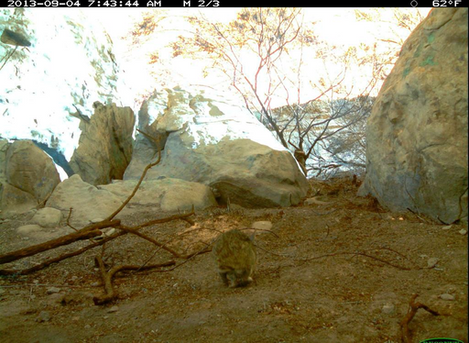
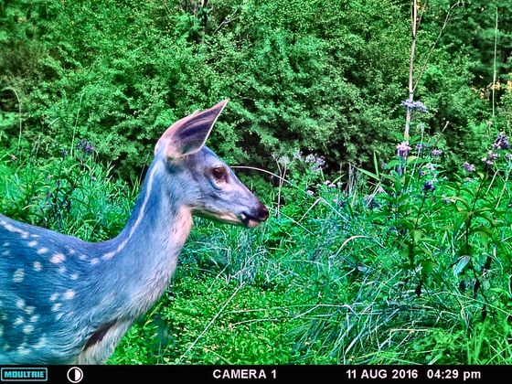
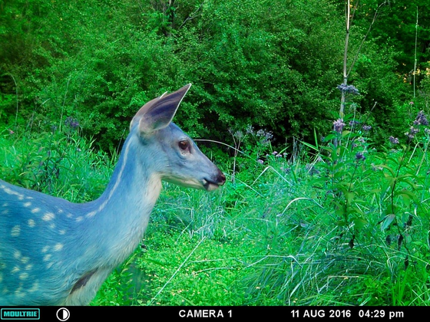
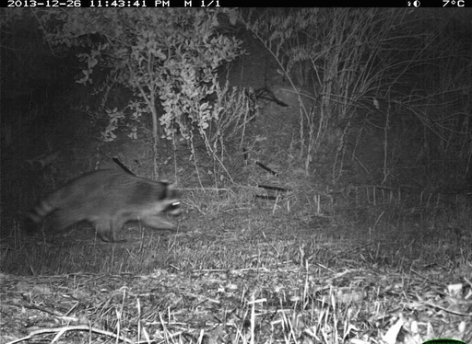
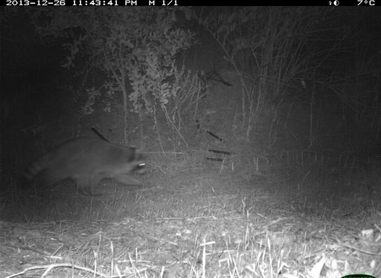
IMAGE PRE-PROCESSING

Slide 8
OBJECT DETECTION
Since the train set is very unbalanced and contains a high percentage of empty images we used a pre-trained object detector to separate between empty and non-empty images.
The goal is to train a model that focuses only on the animal classification task.
We tried the following object detectors:
1. YOLOv5 ("You Only Look Once")
2. FASTER R-CNN ResNet 50 FPN V2
3. FASTER R-CNN MobileNet V3
Finally, the detector that was chosen is MobileNet V3 using a threshold value of 0.3.
Note: All the detectors were pre-trained on the Coco2017 dataset

Slide 9
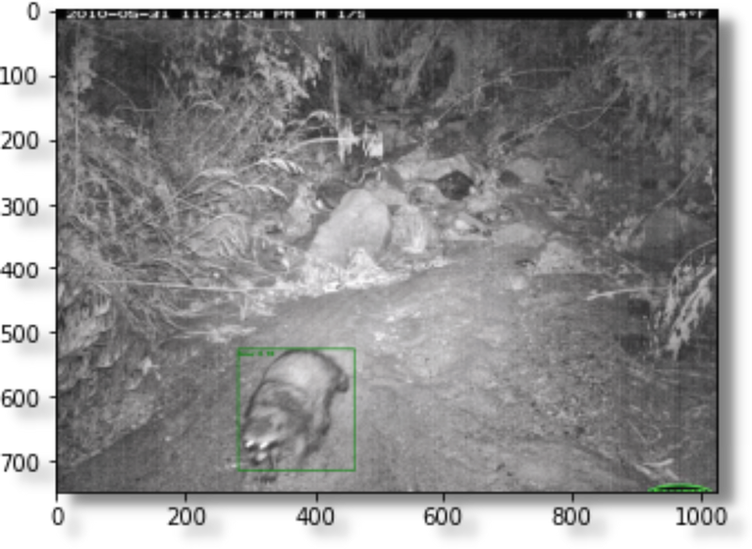
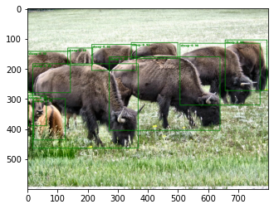
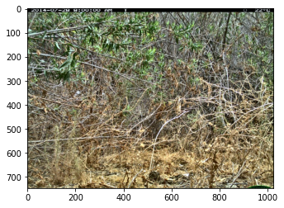
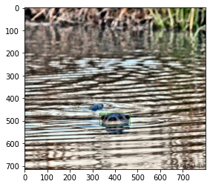
MobileNET V3 in Action:

Slide 10
DETECTOR EVALUATION
The performance achieved using MobileNet V3 pre-trained object detector is:
‎10.8‎%
‎7.5‎%
‎81.7‎%
False Negative
False Positive
Overall Accuracy
114,918 | 24,165
16.539 | 66,390
Empty
Animal Identification Accuracy: 73.31%
Background Identification Accuracy: 87.42%
Predicted
Animal
Empty
Animal
True Label

Slide 11
DETECTOR EVALUATION
Miss Rate Per-Label (%)
Label Distribution After Detector's Filter
Rodent
Deer
Opossum
Raccoon
Coyote
Rabbit
Rabbit
Bobcat
Squirrel
Cat
Opossum
Small Mammal
Dog
Fox
Skunk
Squirrel
Small Mammal
Rodent
Black Bear
Antelope
Bison
Bobcat
Sheep
Mountain Lion
Mountain Goat
Raccoon
Wolf
Moose
Elk
Mountain Lion
Coyote
10,000
Dog
Skunk
Cat
7,500
Goat
Wolf
Black Bear
Fox
5,000
Deer
Antelope
Sheep
2,500
Moose
Bison
Elk
0
0
10
20
30
40

Slide 12
MODEL
TESTED MODELS
We performed transfer learning on several well-known Convolutional Neural Networks architectures.
All these CNNs are pre-trained on
'ImageNet V1' dataset (~400 different animals labels), we replaced the classifier according to the iWildCam 2019 dataset and trained our model to fit the new
classification task.
VGG16
ResNet50
DenseNet121
EfficientNet-B7
EfficientNet-m
RegNetY-16GF
TRANSFORMATION
Resizing images to 224x224
Converting to tensors
Normalization
HYPER-PARAMETERS
Epochs: 6
Batch Size: 8
Optimizer: Adam
Learning Rate: 0.001
Loss Criteria: Cross-Entropy
https://www.kaggle.com/code/bonhart/pytorch-eda-and-resnet

Slide 13

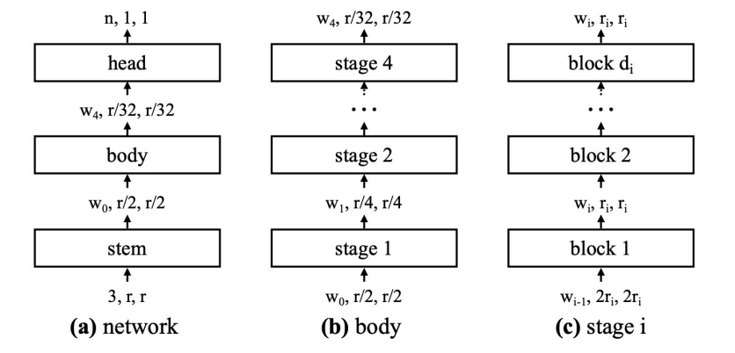
ARCHITECTURE
REGNET-Y-16GF
Stem is 3x3 convolutional layer.
Body is 4 stages each containing multiple blocks.
Head is the final fully-connected layer, We replaced the given classifier with a custom one that is fit to our train data-set.
Radosavovic et al, “Designing Network Design Spaces”, CVPR 2020

Slide 14
Accuracy Per Epoch
Validation
Train
100%
TRAINING
75%
Best Model
The usage of an object detector reduced our training dataset by X3 of the number of images in the original data. This reduction effect directly on the total training time.
Epoch #3 achieved the best accuracy before overfitting.
50%
25%
0%
Epoch 0
Epoch 1
Epoch 2
Epoch 3
Epoch 4
Epoch 5
Epoch 6
Loss Per Epoch
Validation
Train
0.02
0.015
Best Model
0.01
0.005
0
Epoch 1
Epoch 2
Epoch 3
Epoch 4
Epoch 5
Epoch 6

Slide 15
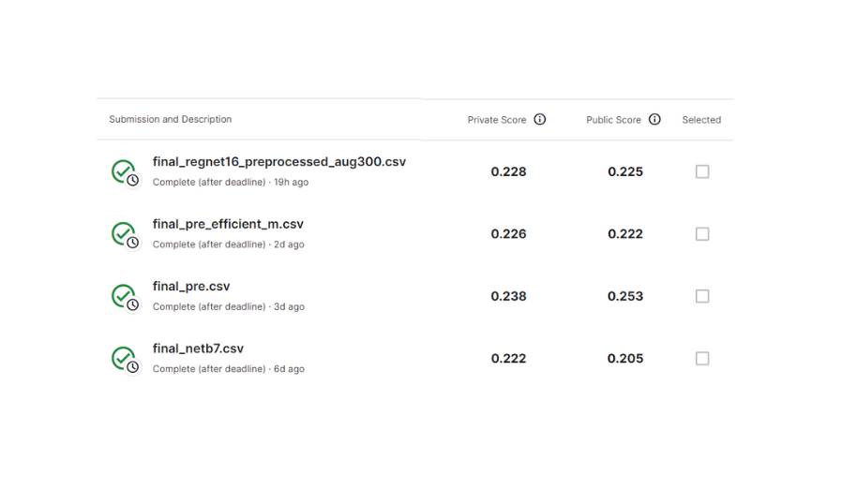
RESULTS
Best Score

Slide 16
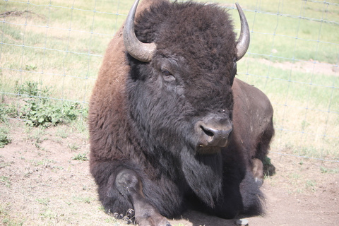
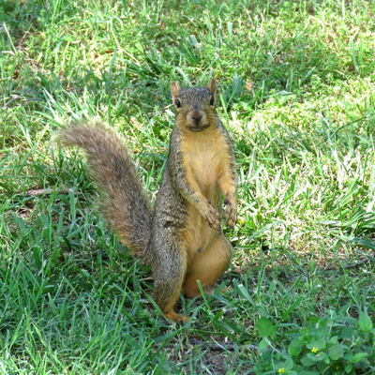
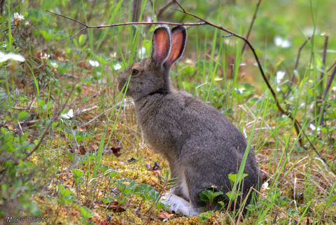
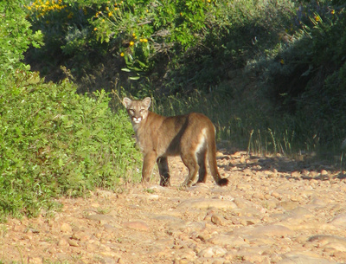
FUTURE WORK
Train the detector on labels with high miss-rate: Rodent, Rabbit, Opossum, and Squirrel.
Improve the image pre-processing step to optimize the ability of feature extraction.
Train on high-resolution train images.

Slide 17
THANK YOU
FOR WATCHING

